Slide 1
Analysing Promotion Prediction Data
By
Mohamed Arsh

Slide 2
Objective
Build a model using machine learning techniques to identify the right people for promotion

Slide 3
Dataset Variables
Employee ID: Unique identifier for each employee
Demographics: Age, gender, region, education, etc.
Training Details: no_of_trainings, previous_year_rating, avg_training_score, etc.
Metrics: KPI, awards, service, etc.
is_promoted: Target variable indicate whether the employee recommended for Promotion

Slide 4
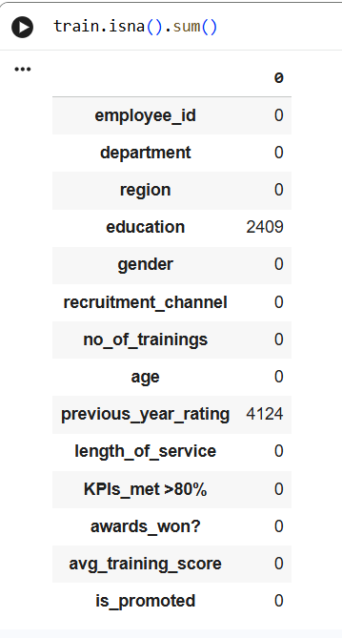
Data cleaning and preprocessing
Education variable is filled with ‘Unknown’
Previous_year_rating is imputed with median of the rating

Slide 5
Feature engineering & validation data split
Numerical Features:
no_of_trainings
age
length_of_service
avg_training_score
previous_year_rating
Categorical Features:
Department
Region
Education
gender recruitment_channel
KPIs_met >80% awards_won?
Data Split:
10% data is used for validation

Slide 6
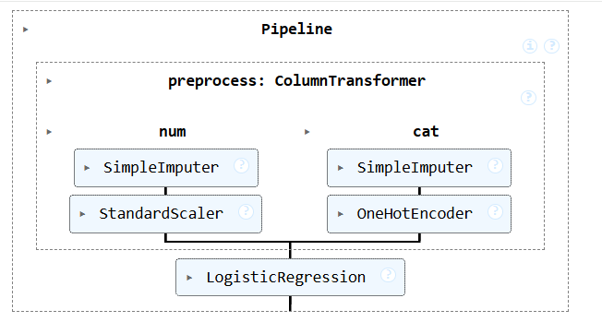
Baseline model
Logistic Regression model is built and evaluated using ROC score and F1 score as metrics
Train Data and Validation Data is nearly the same for both metrics

Slide 7
Model Selection & Hyperparameter Tuning
Objective:
Select the best classification model and hyperparameters using cross-validation.
Defined a parameter grid covering:
  Logistic Regression (regularization type & strength)
  Decision Tree (tree depth)
Used GridSearchCV with:
  2-fold cross-validation
  ROC-AUC as the scoring metric
Why ROC-AUC?
Dataset is imbalanced
ROC-AUC evaluates ranking ability independent of class threshold
Outcome:
Grid search systematically evaluated multiple model–parameter combinations and identified the best performer.

Slide 8
Class Imbalance & Model Evaluation
Model Evaluation:
Trained grid search on oversampled data
Extracted:
  Best hyperparameters
  Best estimator (full pipeline)
Analyzed cross-validation results using:
  Mean ROC-AUC
  Model ranking
Outcome:
A balanced, well-tuned model with improved sensitivity to promotions.
Problem:
Promotion class was under-represented.
Solution:
Applied RandomOverSampler to balance training data
Ensured equal representation of promoted and non-promoted employees

Slide 9
Prediction & Final Submission
Prediction Process:
Used the best estimator to generate promotion probabilities
Converted probabilities into binary predictions using a threshold
Submission Creation:
Created final prediction column (is_promoted)
Exported results in the required CSV format
Final Submission:
Combined oversampling + grid search + ROC-AUC optimization

Slide 10
Streamlit deployment link
Please click the below link to access the frontend app
https://we25hack3-1020112675950.asia-south2.run.app/

